Slide 1

Chapter 5
Analog Transmission

Slide 2
5.1 DIGITAL-TO-ANALOG CONVERSION
Digital-to-analog conversion is the process of changing one of the characteristics of an analog signal based on the information in digital data.
Topics discussed in this section:
Aspects of Digital-to-Analog Conversion
Amplitude Shift Keying
Frequency Shift Keying
Phase Shift Keying
Quadrature Amplitude Modulation

Slide 3

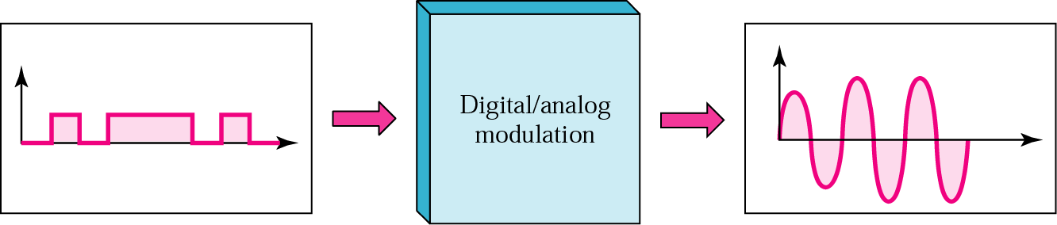
5.1 Digital-to-Analog Conversion
Figure 5.1 Digital-to-analog conversion

Slide 4

Digital-to-Analog Conversion (cont’d)
Type of Digital-to-Analog encoding

Slide 5
Digital-to-Analog Conversion
Data Rate Vs Signal rate
  Data (bit) rate : the number of bits per second.
  Signal (baud) rate : the number of signal elements per second.
  S = N x 1/r
    where N= data rate (bit per second)
    r= log₂ L (No. of data elements carried in one signal element)
  Bit rate = baud rate x No. of bits represented by each signal element
  In the analog transmission of digital data, the Baud rate is less than or equal to the bit rate
Carrier Signal or Carrier Frequency
  base signal for the information signal

Slide 6
Digital-to-Analog Conversion (cont’d)
Example 5.1
An analog signal carries 4 bits per signal element. If 1000 signal elements are sent per second, find the baud rate and bit rate.
Solution
In this case, r = 4, S = 1000, and N is unknown. We can find the value of N from
  Baud rate = Number of signal elements = 1000 bauds per second

Slide 7

Digital-to-Analog Conversion (cont’d)
Example 5.2
An analog signal has a bit rate of 8000 bps and a baud rate of 1000 baud. How many data elements are carried by each signal element? How many signal elements do we need?
Solution
In this example, S = 1000, N = 8000, and r and L are unknown. We find first the value of r and then the value of L.

Slide 8
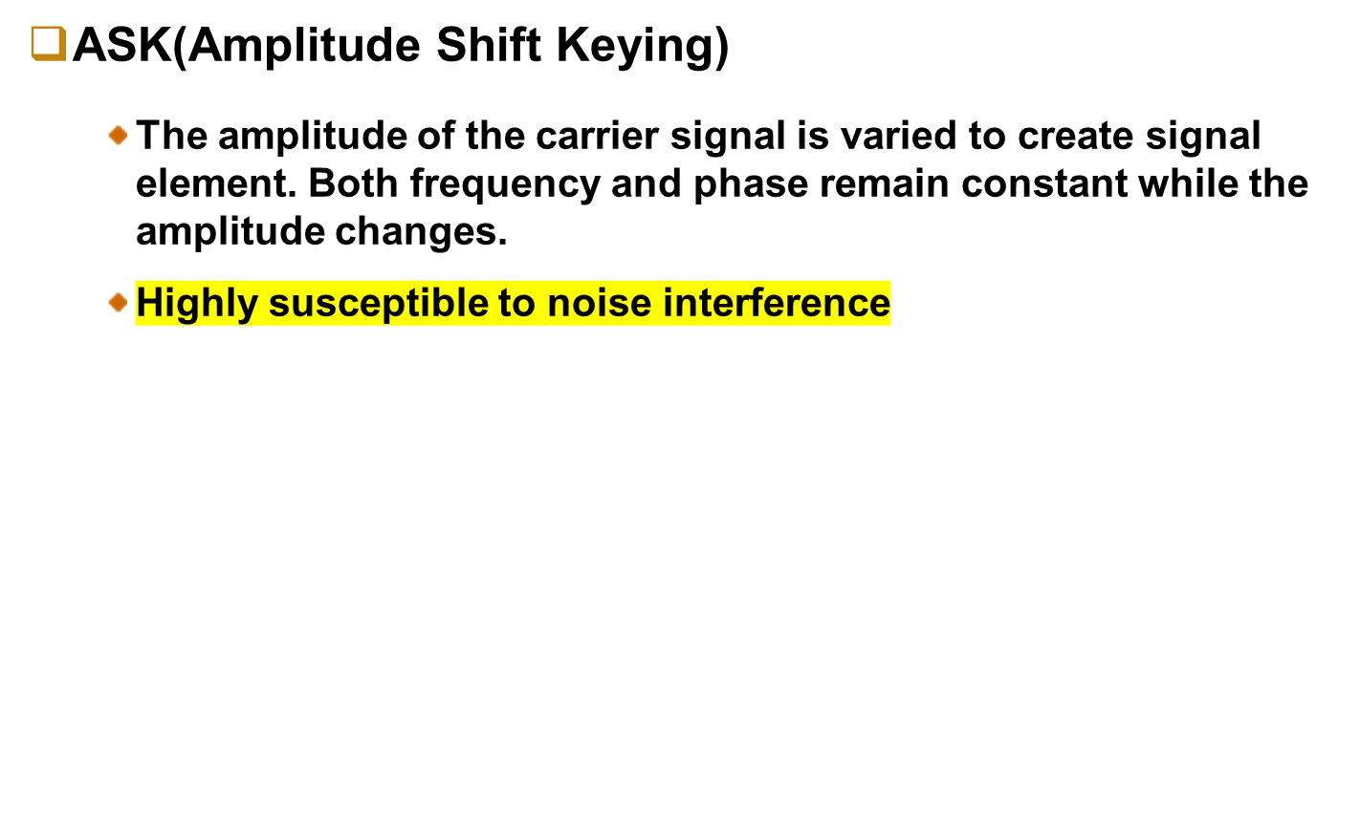

Digital-to-Analog Conversion - ASK
Figure 5.3 Binary amplitude shift keying

Slide 9
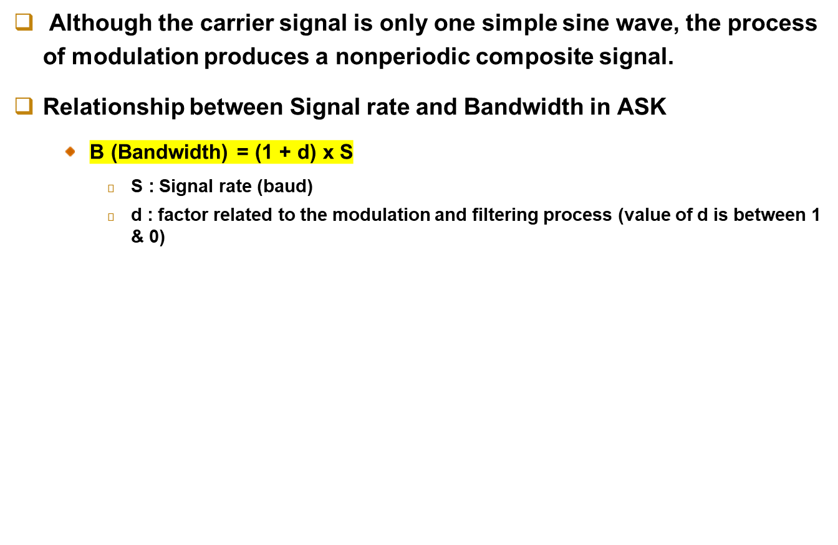
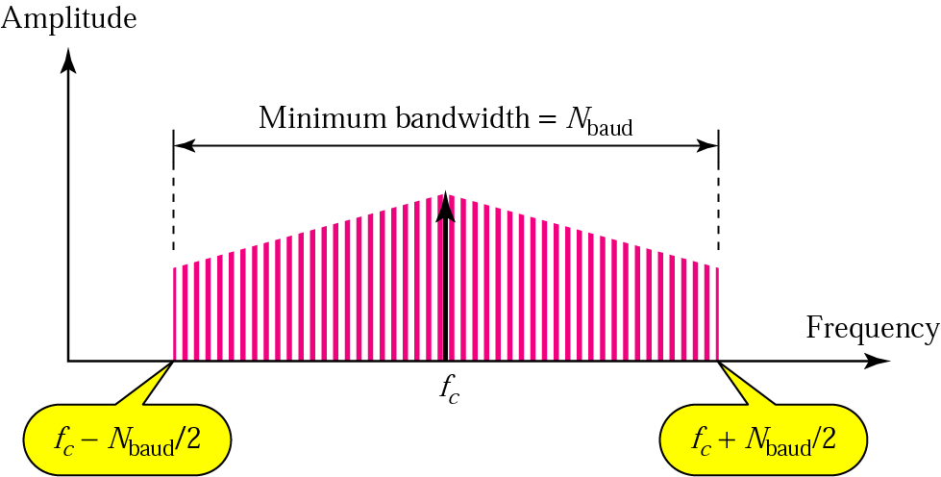
Digital-to-Analog Conversion - ASK
Bandwidth for ASK
= S
Maximum Bandwidth = 2S

Slide 10

Digital-to-Analog Conversion - ASK
Figure 5.4 Implementation of binary ASK

Slide 11
Digital-to-Analog Conversion - ASK
Example 5.3
We have an available bandwidth of 100 kHz which spans from 200 to 300 kHz. What are the carrier frequency and the bit rate if we modulated our data by using ASK with d = 1?
Solution
The middle of the bandwidth is located at 250 kHz. This means that our carrier frequency can be at f_{c} = 250 kHz. We can use the formula for bandwidth to find the bit rate (with d = 1 and r = 1).

Slide 12

Digital-to-Analog Conversion - ASK
Example 5.4
In data communications, we normally use full-duplex links with communication in both directions. We need to divide the bandwidth into two with two carrier frequencies, as shown in Figure 5.5. The figure shows the positions of two carrier frequencies and the bandwidths. The available bandwidth for each direction is now 50 kHz, which leaves us with a data rate of 25 kbps in each direction.
Figure 5.5 Bandwidth of full-duplex ASK used in Example 5.4

Slide 13



Digital-to-Analog Conversion - FSK
FSK(Frequency Shift Keying)
  the frequency of the carrier signal is varied to represent binary 1 or 0. (Peak amplitude and phase remain constant)
Figure 5.6 Binary frequency shift keying
Both f₁ & f₂ are Δf apart from the midpoint between the two bands.
The difference between the two frequency is 2Δf

Slide 14
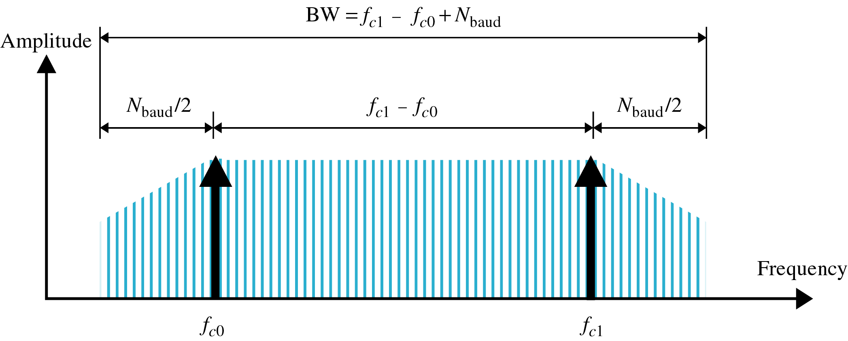
Digital-to-Analog Conversion - FSK
Bandwidth for FSK
  The carrier signals are only simple sine waves, but the modulation creates a nonperiodic composite signal with continuous frequencies.
  FSK as two ASK signals, each with its own carrier frequency (f₁ or f₂)
B_{FSK} (Bandwidth) = (1+d) x S + 2Δf
= (1+d) x S + 2Δf

Slide 15
Digital-to-Analog Conversion - FSK
Example 5.5
We have an available bandwidth of 100 kHz which spans from 200 to 300 kHz. What should be the carrier frequency and the bit rate if we modulated our data by using FSK with d = 1?
Solution
This problem is similar to Example 5.3, but we are modulating by using FSK. The midpoint of the band is at 250 kHz. We choose 2Δf to be 50 kHz; this means

Slide 16

Digital-to-Analog Conversion - FSK
Figure 5.7 Implementation of binary FSK

Slide 17
Digital-to-Analog Conversion - FSK
MFSK : Multilevel FSK
We can send data 2-bits at a time by using 4 frequencies.
B_{MFSK} (Bandwidth) = (1+d) x S + (L-1)2Δf => L x S
  The minimum value of 2Δf should be at least S for the proper operation of modulation and demodulation.

Slide 18

Digital-to-Analog Conversion - FSK
Example 5.6
We need to send data 3 bits at a time at a bit rate of 3 Mbps. The carrier frequency is 10 MHz. Calculate the number of levels (different frequencies), the baud rate, and the bandwidth.
Solution
We can have L = 2³ = 8. The baud rate is S = 3 MHz/3 = 1 Mbaud. This means that the carrier frequencies must be 1 MHz apart (2Δf = 1 MHz). The bandwidth is B = 8 × 1000 = 8000KHz.
Figure 5.8 shows the allocation of frequencies and bandwidth.

Slide 19

Digital-to-Analog Conversion - PSK
PSK
  The phase of the carrier is varied to represent two or more different signal elements.
  Both peak amplitude and frequency remain constant as the phase changes.
Figure 5.9 Binary phase shift keying

Slide 20
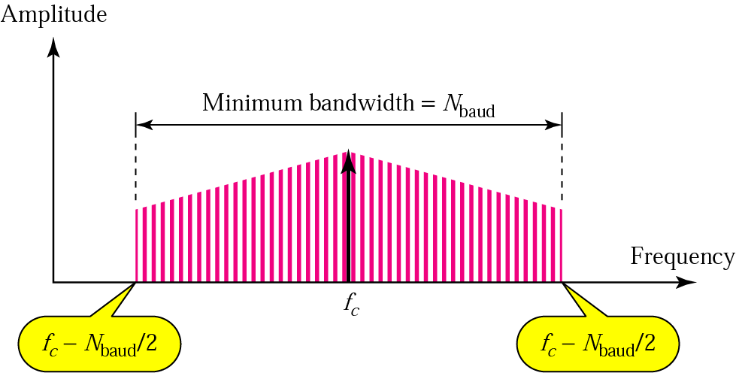
Relationship between baud rate and bandwidth in PSK
The bandwidth is the same as that for binary ASK, but less than that for BFSK.
+

Slide 21
Digital-to-Analog Conversion - PSK
BPSK (Phase Shift Keying)
  the phase is varied to represent binary 1 or 0.
bit
phase
1
0
0
1
0º
180º
Constellation diagram

Slide 22

Digital-to-Analog Conversion - PSK
Figure 5.10 Implementation of BPSK

Slide 23
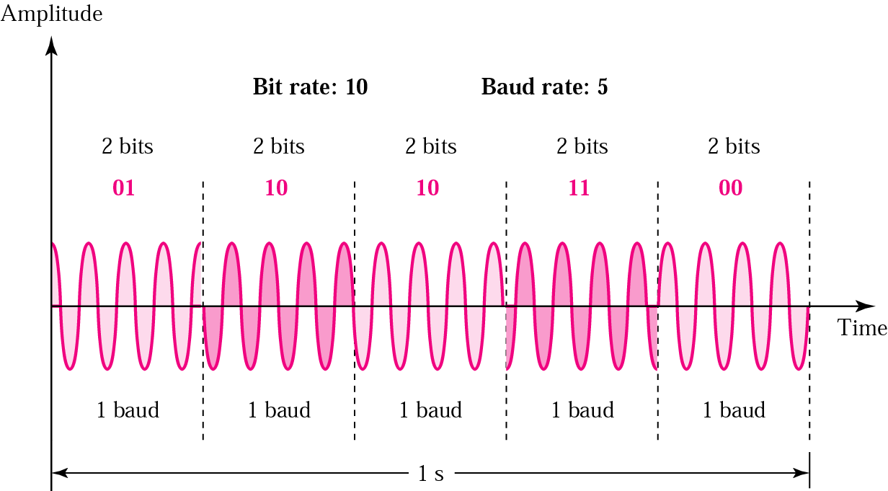
QPSK(4-PSK) method
Instead of utilizing only two variations of a signal, We can use
4 variations and let each phase shift represent 2 bits.
This technique is called 4-PSK or Q-PSK.

Slide 24

QPSK(4-PSK) method
Figure 5.11 QPSK and its implementation

Slide 25
QPSK(4-PSK) method
Example 5.7
Find the bandwidth for a signal transmitting at 12 Mbps for QPSK. The value of d = 0.
Solution
For QPSK, 2 bits is carried by one signal element.
This means that r = 2.
So the signal rate (baud rate) is S = N × (1/r) = 6 Mbaud. With a value of d = 0, we have B = S = 6 MHz.

Slide 26

Constellation Diagram
Figure 5.12 Concept of a constellation diagram

Slide 27

Constellation Diagram
Example 5.8
Show the constellation diagrams for an ASK (OOK), BPSK, and QPSK signals.
Solution
Figure 5.13 shows the three constellation diagrams.

Slide 28

Digital-to-Analog Conversion - QAM
QAM(Quadrature Amplitude Modulation)
  Quadrature amplitude modulation is a combination of ASK and PSK so that a maximum contrast between each signal unit (bit, dibit, tribit, and so on) is achieved
Figure 5.14 Constellation diagrams for some QAMs

Slide 29
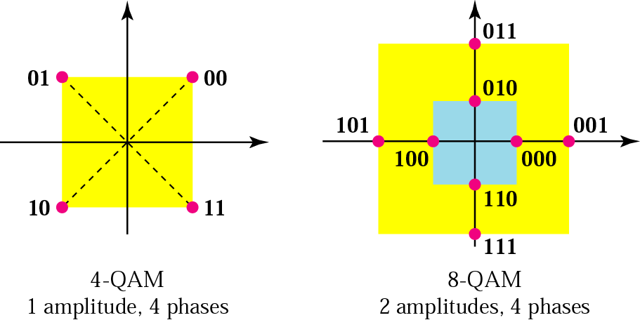
Digital-to-Analog Conversion - QAM

Slide 30
5.2 ANALOG-TO-ANALOG CONVERSION
Analog-to-analog conversion is the representation of analog information by an analog signal. One may ask why we need to modulate an analog signal; it is already analog. Modulation is needed if the medium is bandpass in nature or if only a bandpass channel is available to us.
Topics discussed in this section:
Amplitude Modulation
Frequency Modulation
Phase Modulation

Slide 31
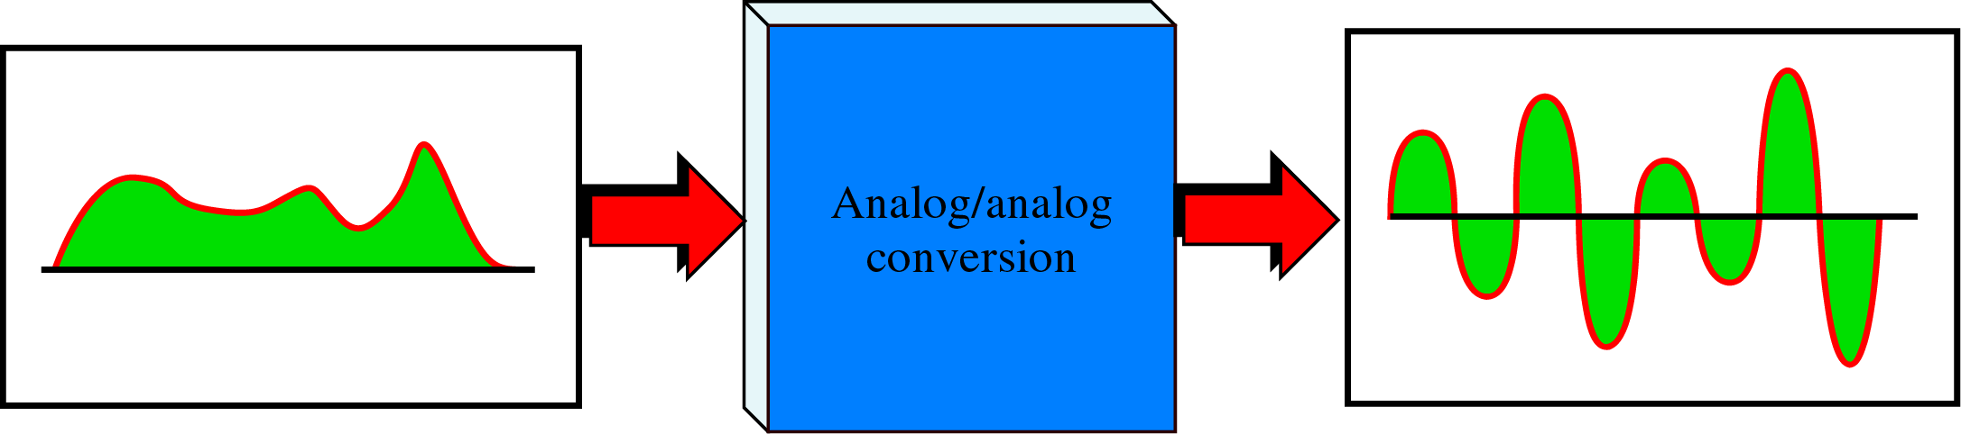
Analog-to-analog Conversion
Analog-to-Analog encoding is the representation of analog information by an analog signal.
Analog-to-Analog encoding

Slide 32

Analog-to-Analog Conversion
Figure 5.15 Types of analog-to-analog modulation

Slide 33

Analog-to-Analog Conversion - AM
AM(Amplitude Modulation)
  ~ The frequency and phase of the carrier remain the same; only the amplitude changes to follow variations in the information.
Figure 5.16 Amplitude modulation

Slide 34
Analog-to-Analog Conversion - AM
AM bandwidth
  The total bandwidth required for AM can be determined from the bandwidth of the audio signal.
The total bandwidth required for AM
can be determined
from the bandwidth of the audio
signal: B_{AM} = 2B.

Slide 35
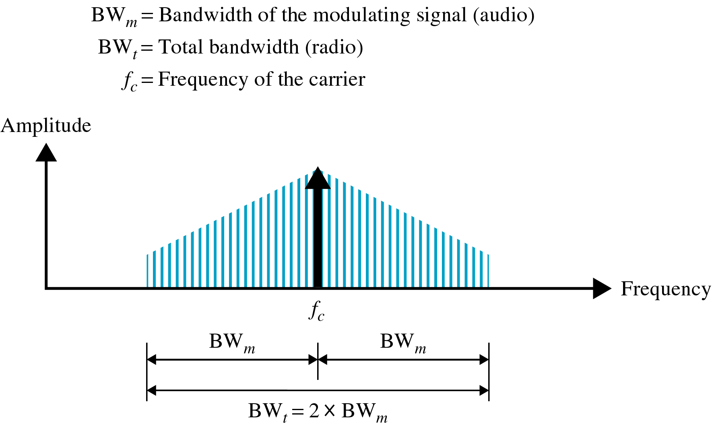
Analog-to-Analog Conversion - AM
AM bandwidth

Slide 36
Analog-to-Analog Conversion - AM
Audio signal bandwidth : 5 KHz
Minimum bandwidth : 10 KHz (bandwidth for AM radio station)
AM stations are allowed carrier frequencies anywhere between 530 and 1700 KHz(1.17 MHz)
each frequency must be separated by 10 KHz

Slide 37
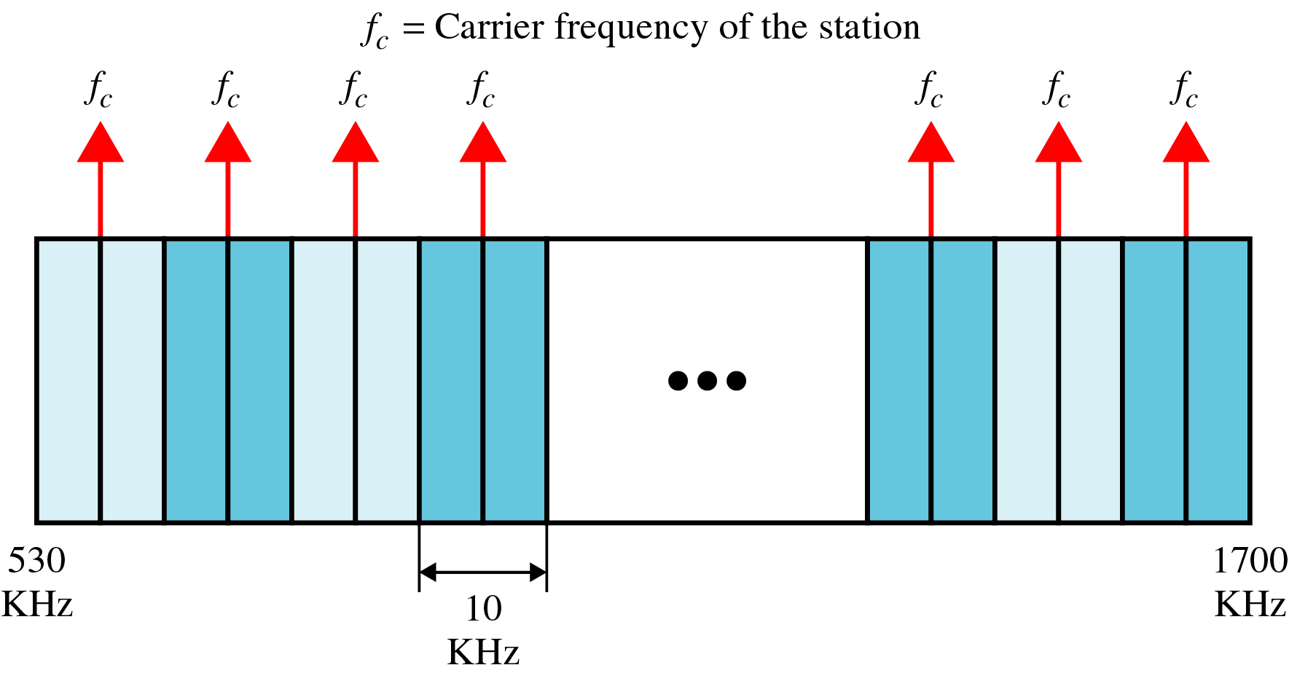
Analog-to-Analog Conversion - AM
AM band allocation

Slide 38
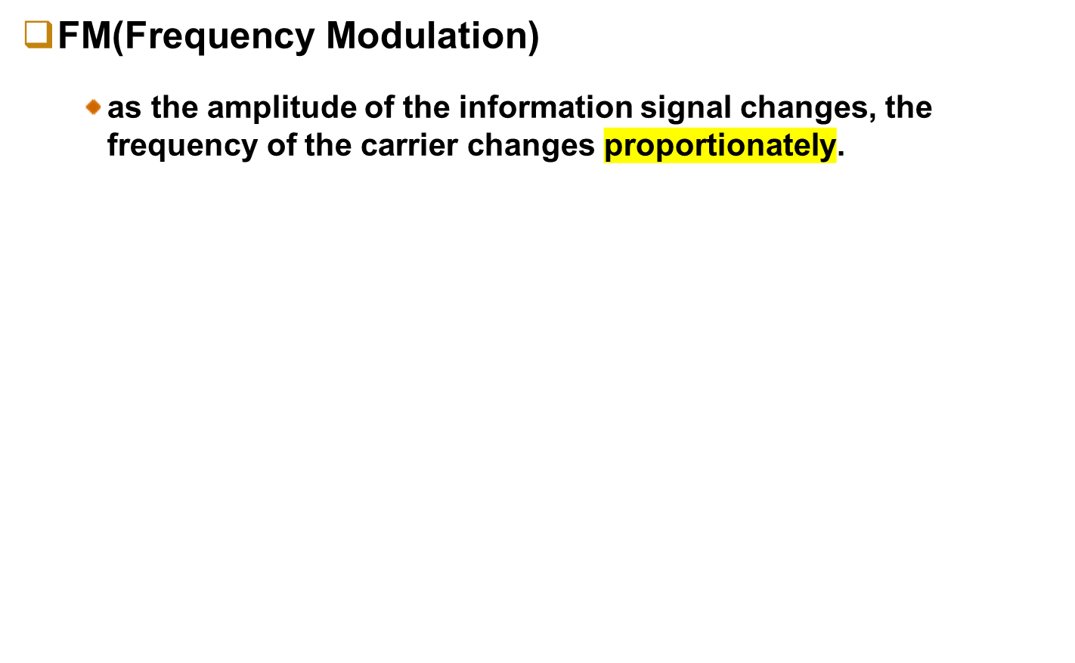

Analog-to-Analog Conversion - FM
Figure 5.18 Frequency modulation
β

Slide 39
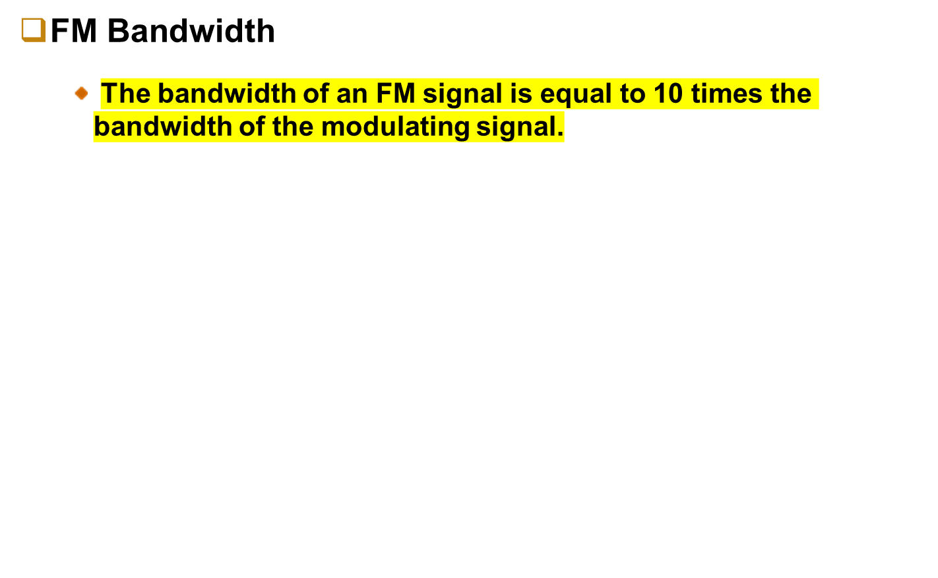
Analog-to-Analog Conversion - FM
The total bandwidth required for FM can be determined from the bandwidth
of the audio signal: B_{FM} = 2(1 + β)B.
β
depends on modulation technique with a common value of 4

Slide 40
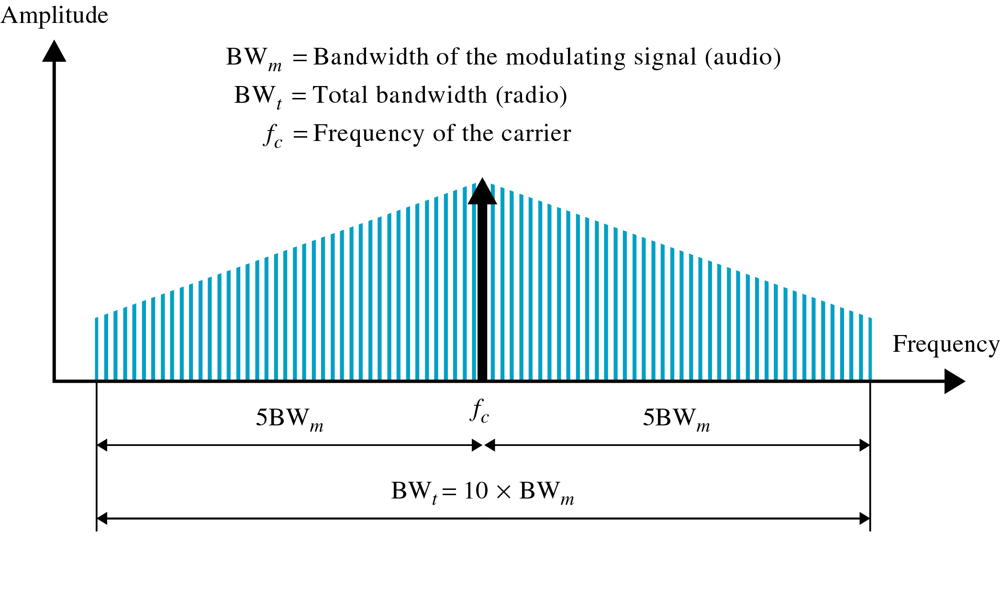
Analog-to-Analog Conversion - FM
FM bandwidth

Slide 41
Analog-to-Analog Conversion - FM
Bandwidth of an audio signal broadcast in stereo : 15 KHz
minimum bandwidth : 150 KHz
allows generally 200 KHz(0.2 MHz) for each station
FM station are allowed carrier frequencies anywhere 88 and 108 MHz (each 200 KHz)

Slide 42
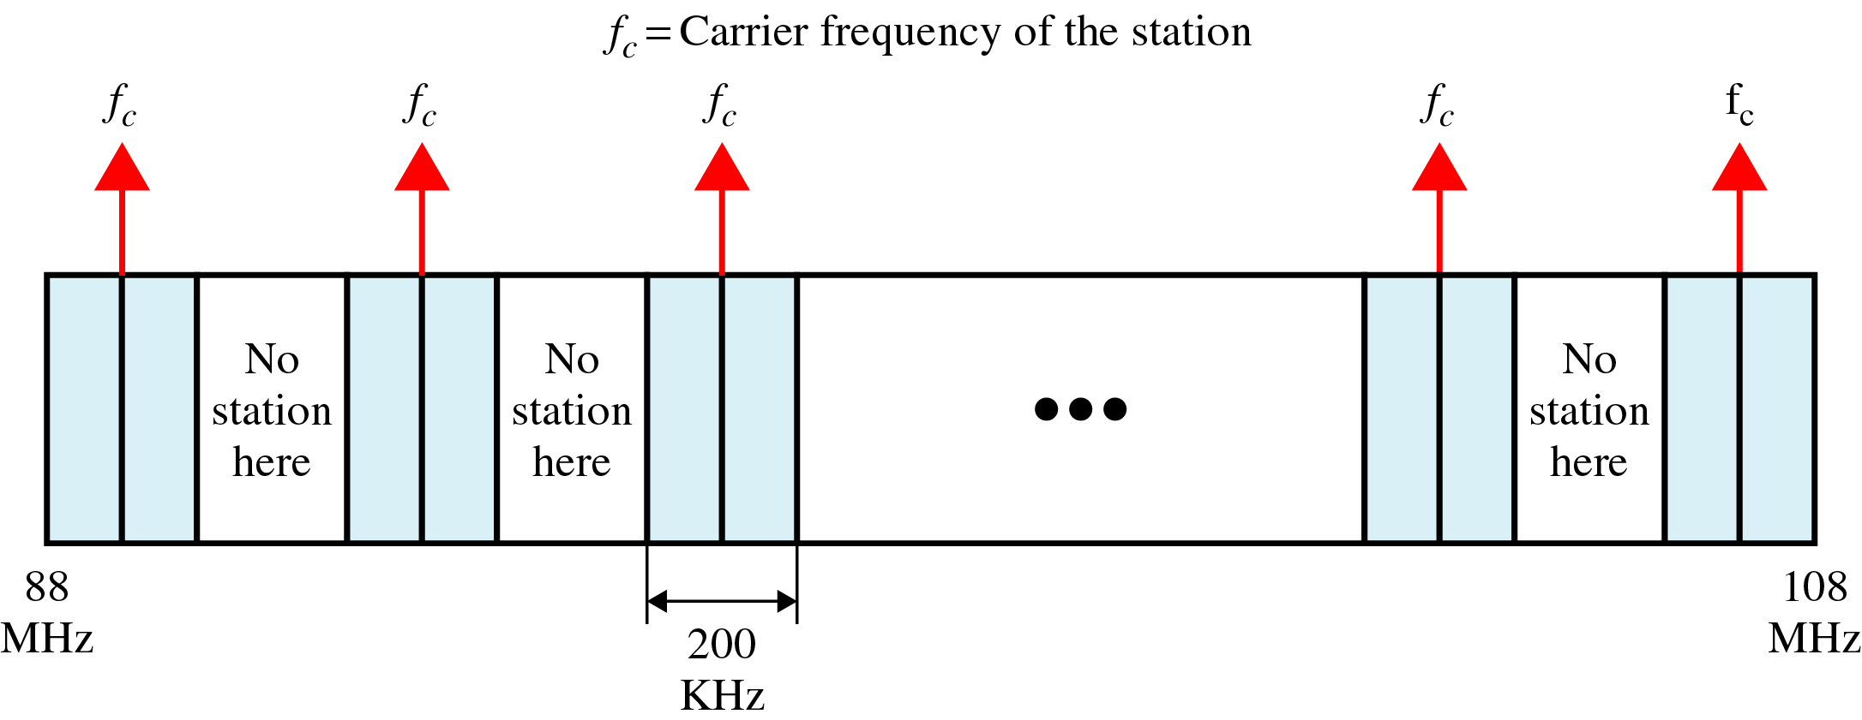
Analog-to-Analog Conversion - FM
FM band allocation
Alternate bandwidth allocation

Slide 43

Analog-to-Analog Conversion - PM
PM(Phase Modulation)
  The phase of the carrier signal is modulated to follow the changing voltage (amplitude) of the modulating signal
  ~ is used in some systems as an alternative to frequency modulation.
Figure 5.20 Phase modulation
β

Slide 44

Analog-to-Analog Conversion - PM
Note
The total bandwidth required for PM can be determined from the bandwidth
and maximum amplitude of the modulating signal:
B_{PM} = 2(1 + β)B.
β
: a factor depending on modulation technique
with around 1 for narrowband and 3 for wideband

Slide 45
Summary (1)
Digital-to-analog conversion is the process of changing one of the characteristics of an analog signal based on the information in the digital data.
Digital-to-analog conversion can be accomplished in several ways: amplitude shift keying(ASK), frequency shift keying (FSK), and phase shift keying(PSK). Quadrature amplitude modulation(QAM) combines ASK and PSK.
In amplitude shift keying, the amplitude of the carrier signal is varied to create signal elements. Both frequency and phase remain constant while the amplitude changes.
In frequency shift keying, the frequency of the carrier signal is varied to represent data. The frequency of the modulated signal is constant for the duration of one signal element, but changes for the next signal element if the data element changes. Both peak amplitude and phase remain constant for all signal elements.

Slide 46
Summary (2)
In phase shift keying, the phase of the carrier is varied to represent two or more different signal elements. Both peak amplitude and frequency remain constant as the phase changes.
A constellation diagram shows us the amplitude and phase of a signal element, particularly diagram when we are using two carriers(one in-phase and one quadrature).
Quadrature amplitude modulation(QAM) is a combination of ASK and PSK. QAM uses two carriers, one in-phase and the other quadrature, with different amplitude levels for each carrier.
Analog-to-analog conversion is the representation of analog information by an analog signal. Conversion is needed if the medium is bandpass in nature or if only a bandpass bandwidth is available to us.
Analog-to-analog conversion can be accomplished in three ways: amplitude modulation(AM), frequency modulation(FM), and phase modulation(PM).

Slide 47
Summary (3)
In AM transmission, the carrier signal is modulated so that its amplitude varies with the changing amplitudes of the modulating signal. The frequency and phases of the carrier remain the same; only the amplitude changes to follow variations in the information.
In FM transmission, the frequency of the carrier signal is modulated to follow the changing voltage level(amplitude) of the modulating signal. The peak amplitude and phase of the carrier signal remain constant, but as the amplitude of the information signal changes, the frequency of the carrier changes correspondingly.
In PM transmission, the phase of the carrier signal is modulated to follow the changing voltage level(amplitude) of the modulating signal. The peak amplitude and frequency of the carrier signal remain constant, but as the amplitude of the information signal changes, the phase of the carrier changes correspondingly.

Slide 48

Q & A

